Slide 1
Spatial Mapping of Human Kidney by Automated Structural MxIF Segmentation
C Heiser, Spring 2019

Slide 2
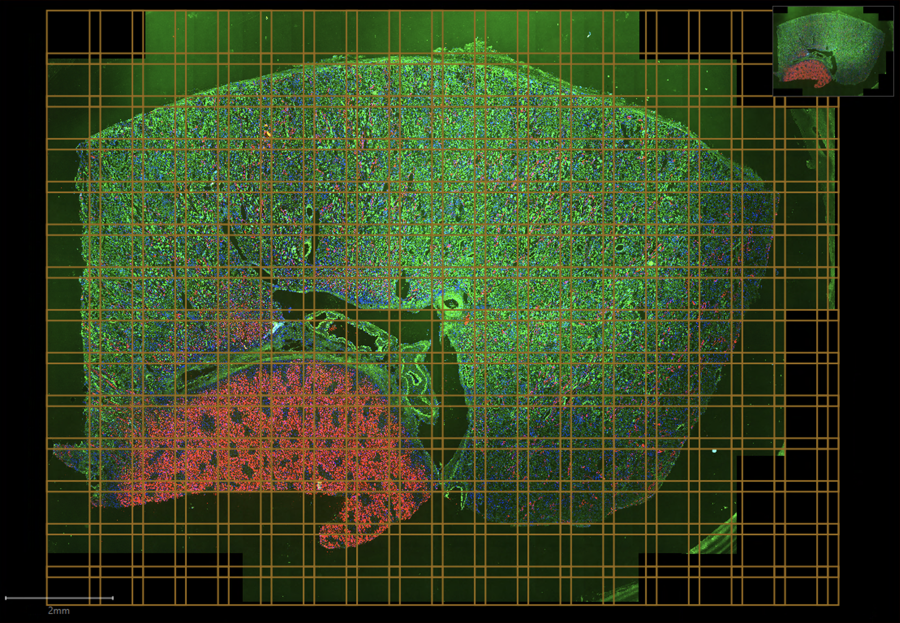
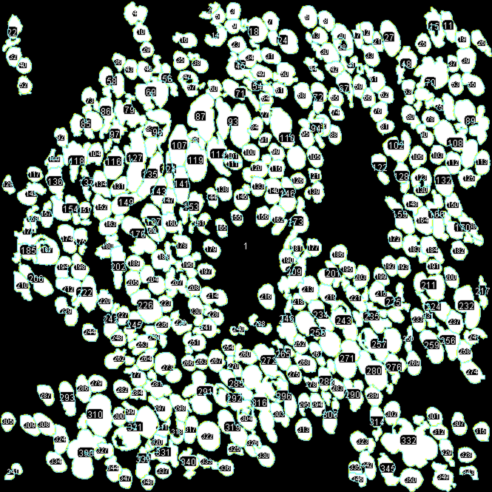
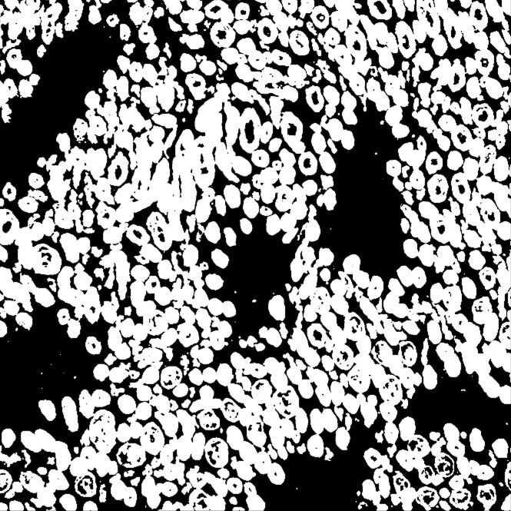
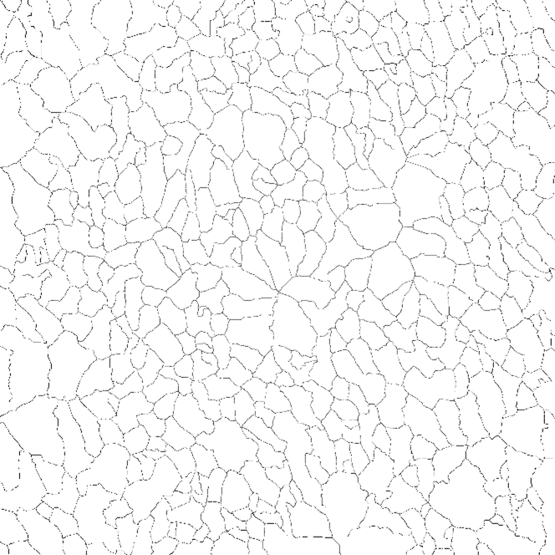
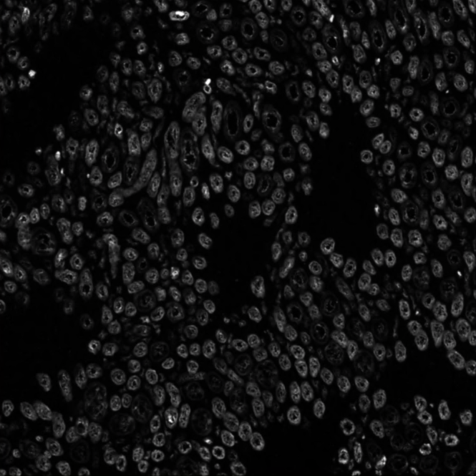
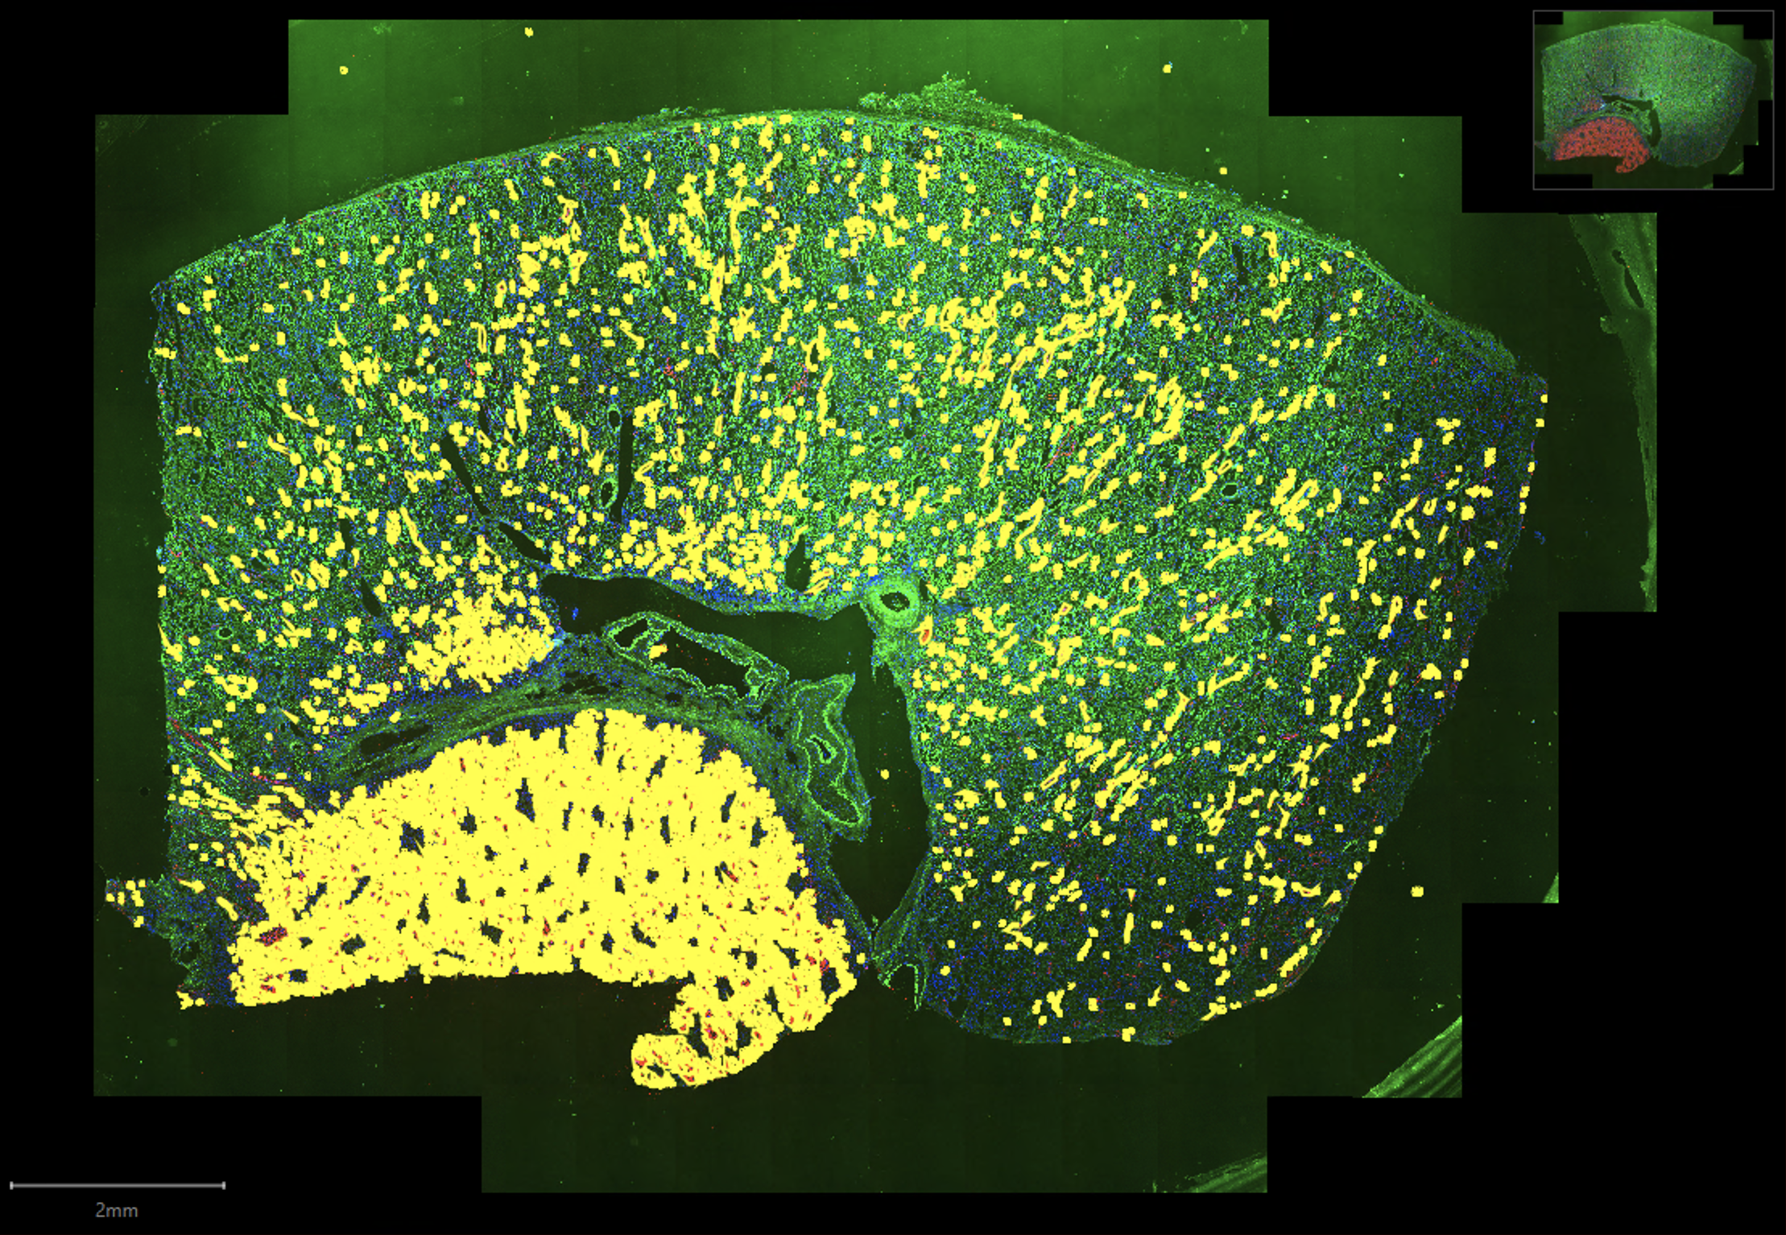
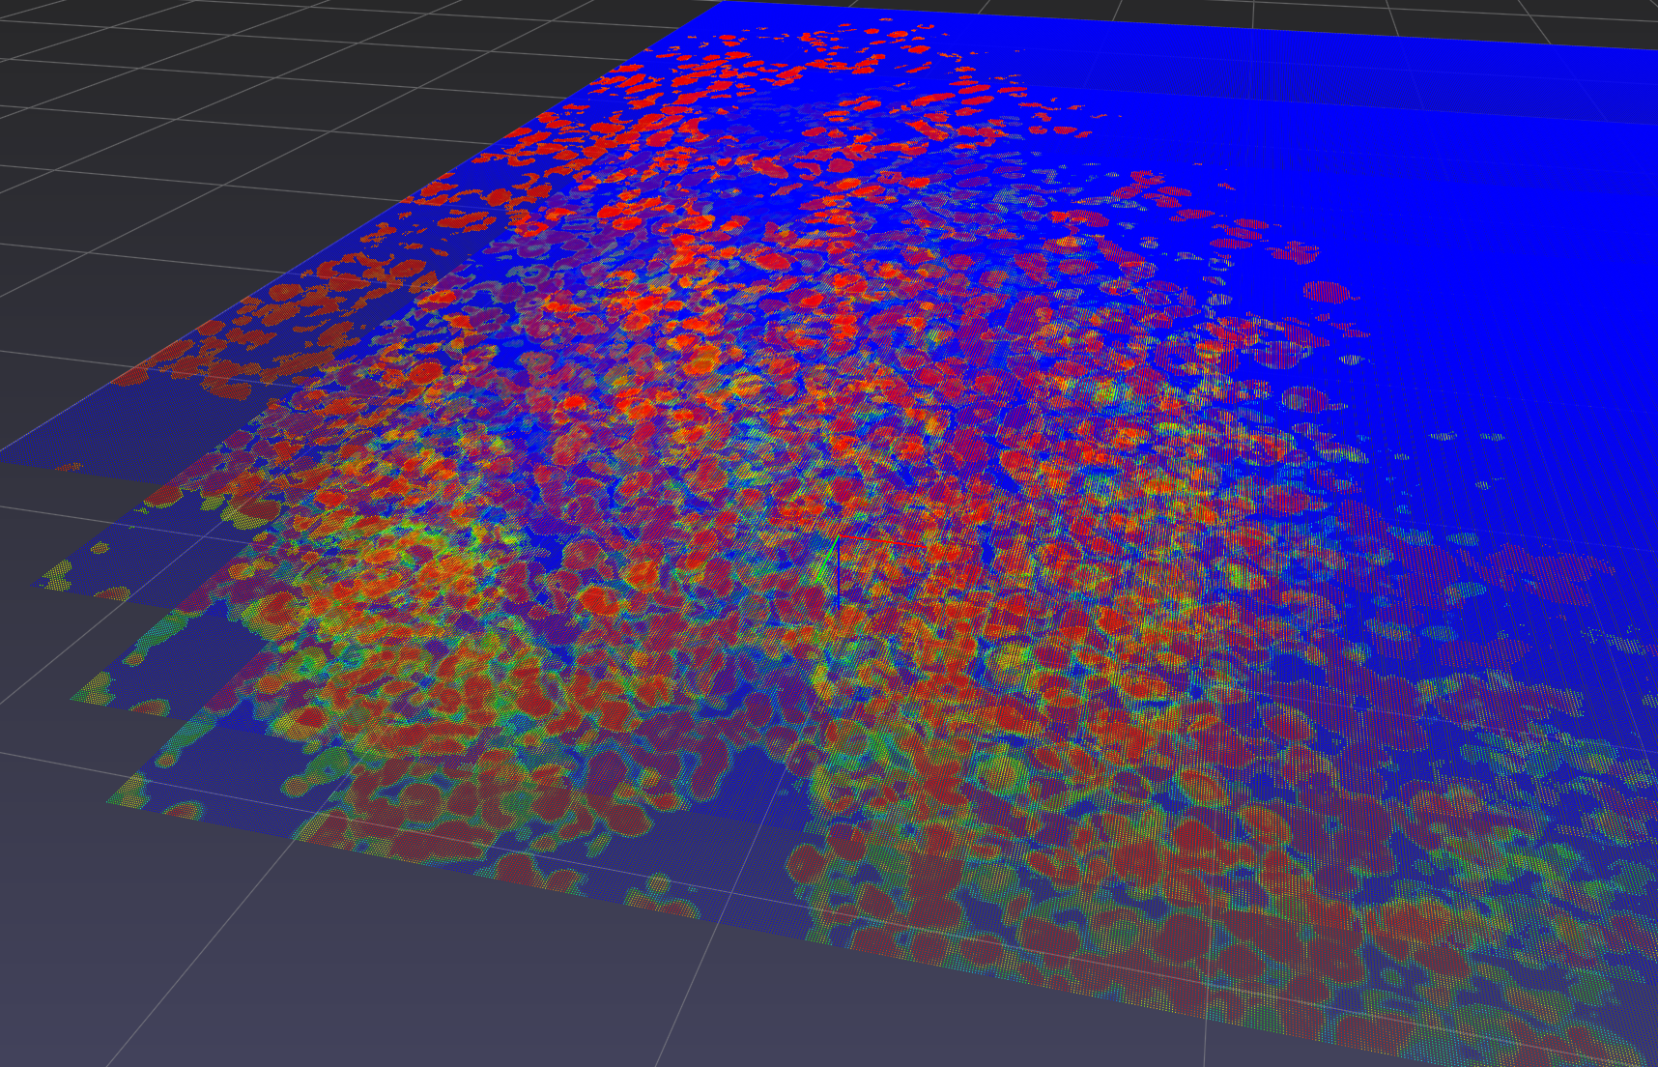
QuPath allows for automated, scalable segmentation of whole-slide images
watershed
ROI detection
whole-slide tiling in QuPath
mapping of kidney structures across serial sections
Annotation
Notes:
QuPath for automating annotation of whole-slide images.
Overlapping tiles in QuPath are analyzed iteratively using watershed function to detect ROIs (red-labeled tubules in this example).
Individual structure annotations can be tracked in 3D across serial tissue images.

Slide 3
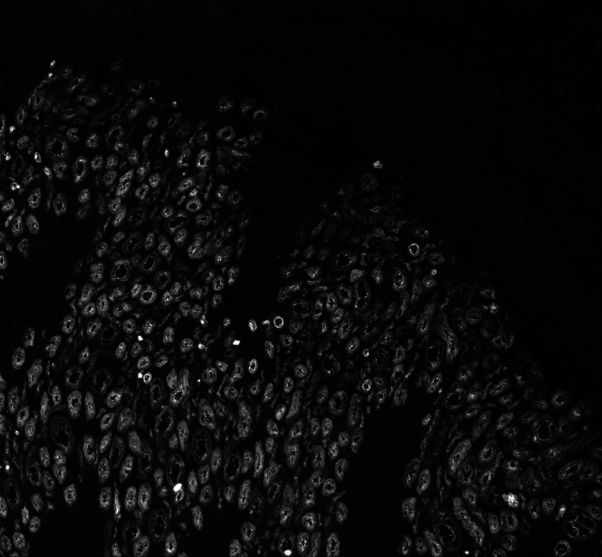
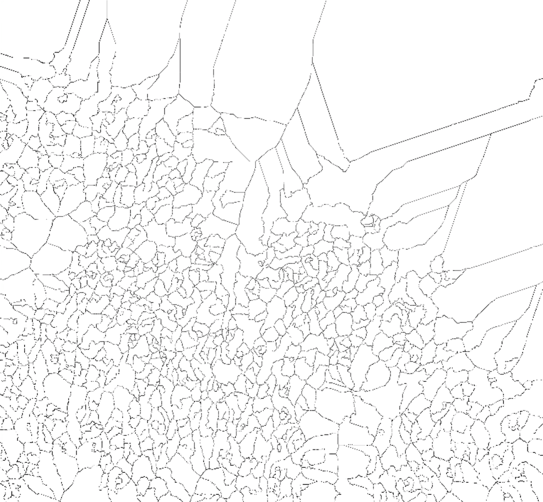
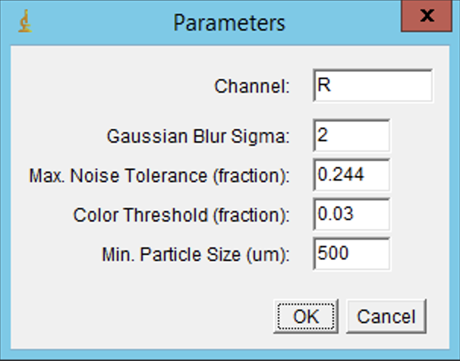
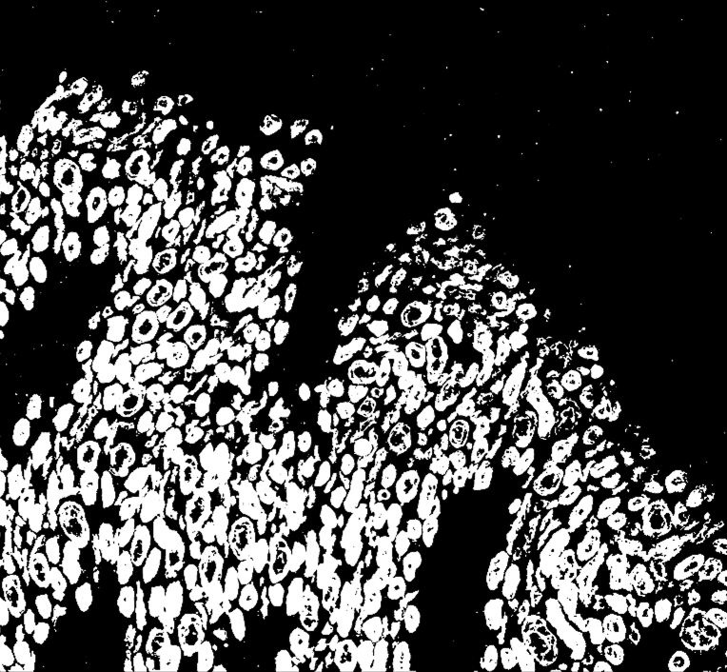
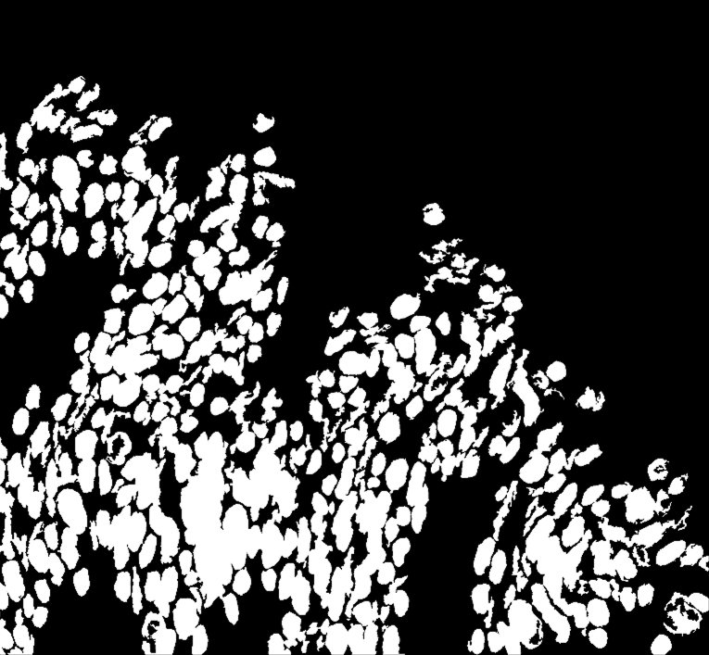
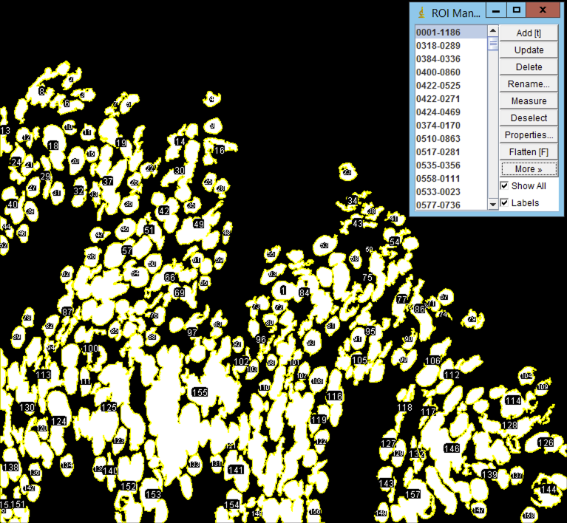
Single-channel sectioning in unified workflow
0. Preprocess & Filter
1. Find Maxima
2. Adjust Threshold
3. Intersect, fill holes
4. Split ROI

Slide 4
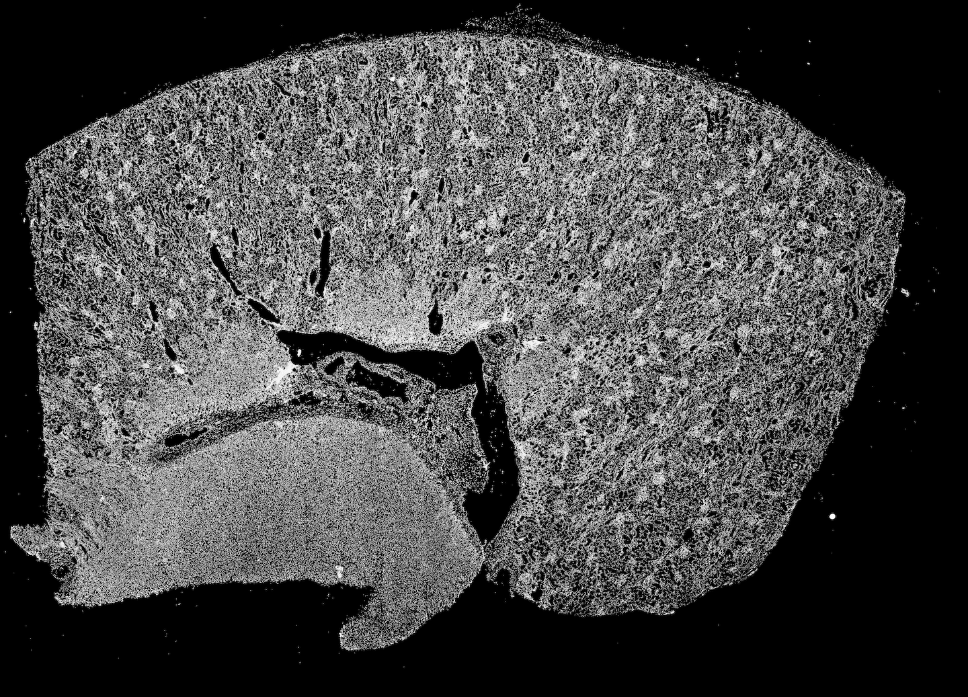
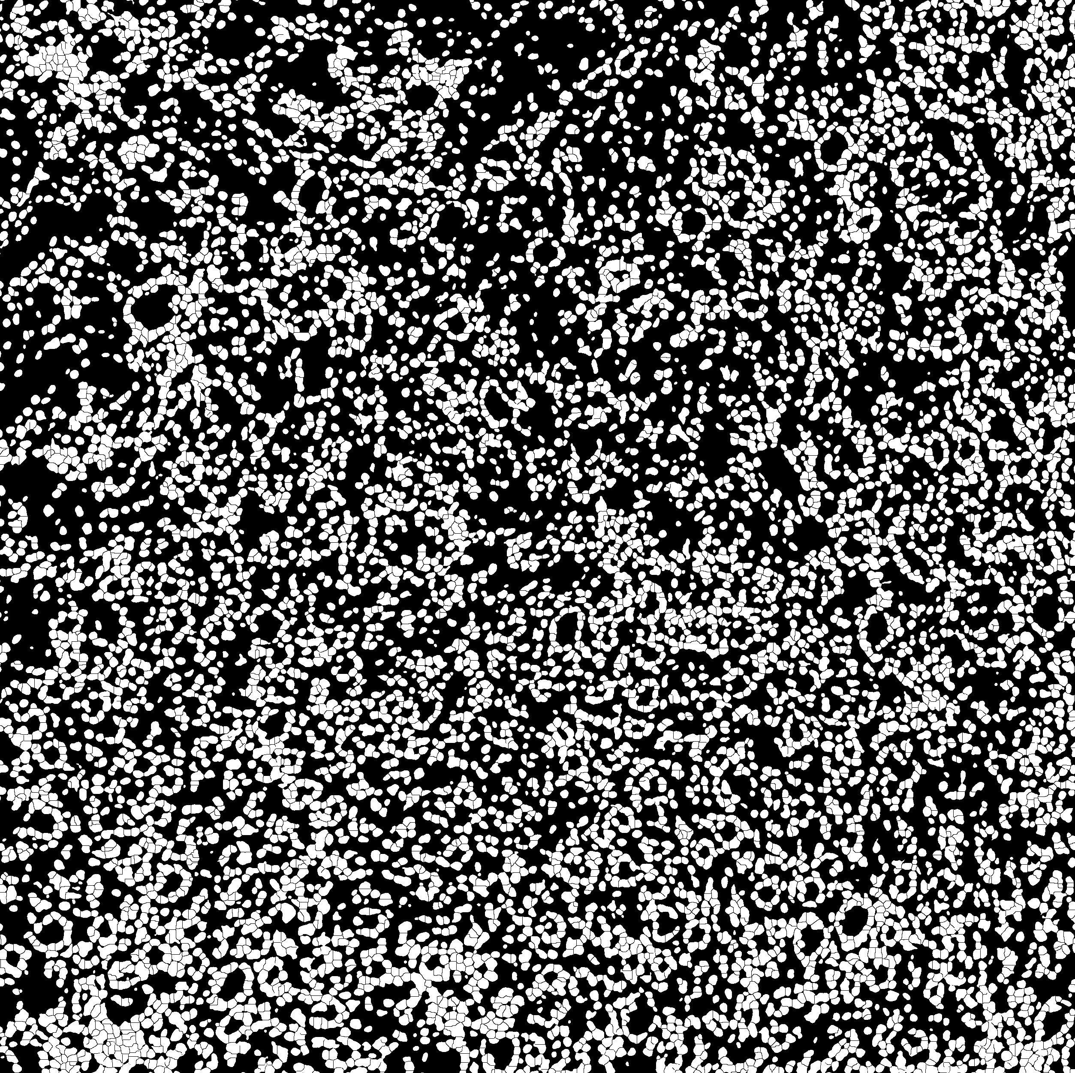
Whole-slide binary mask exports used for fusion with registered IMS and AF data
DAPI

Slide 5
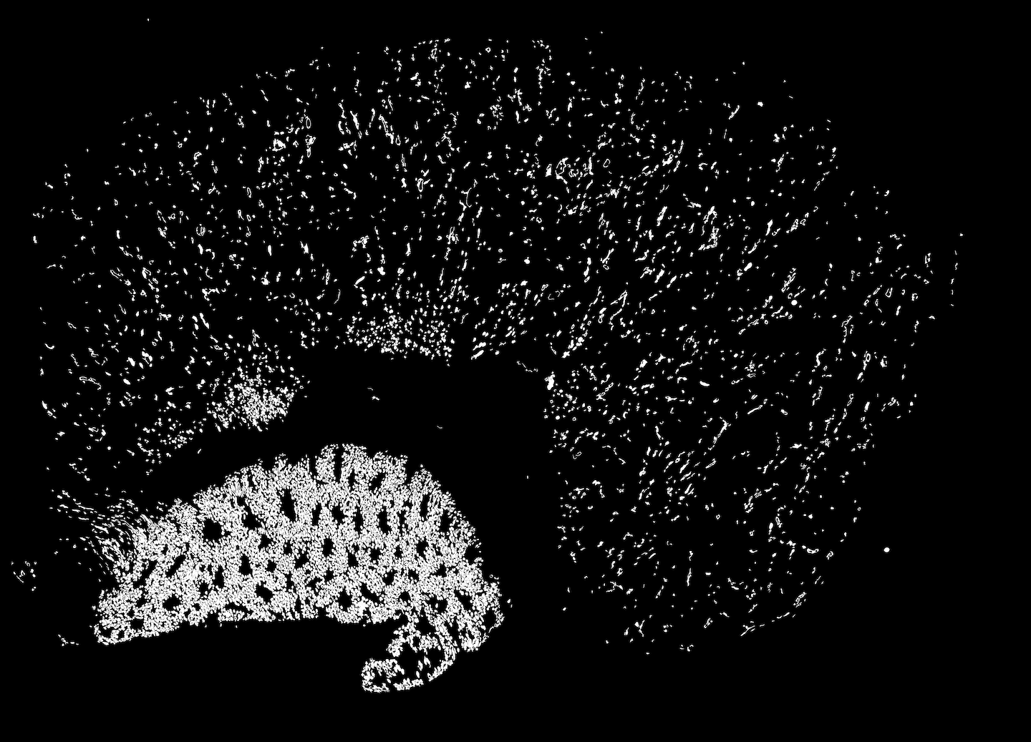
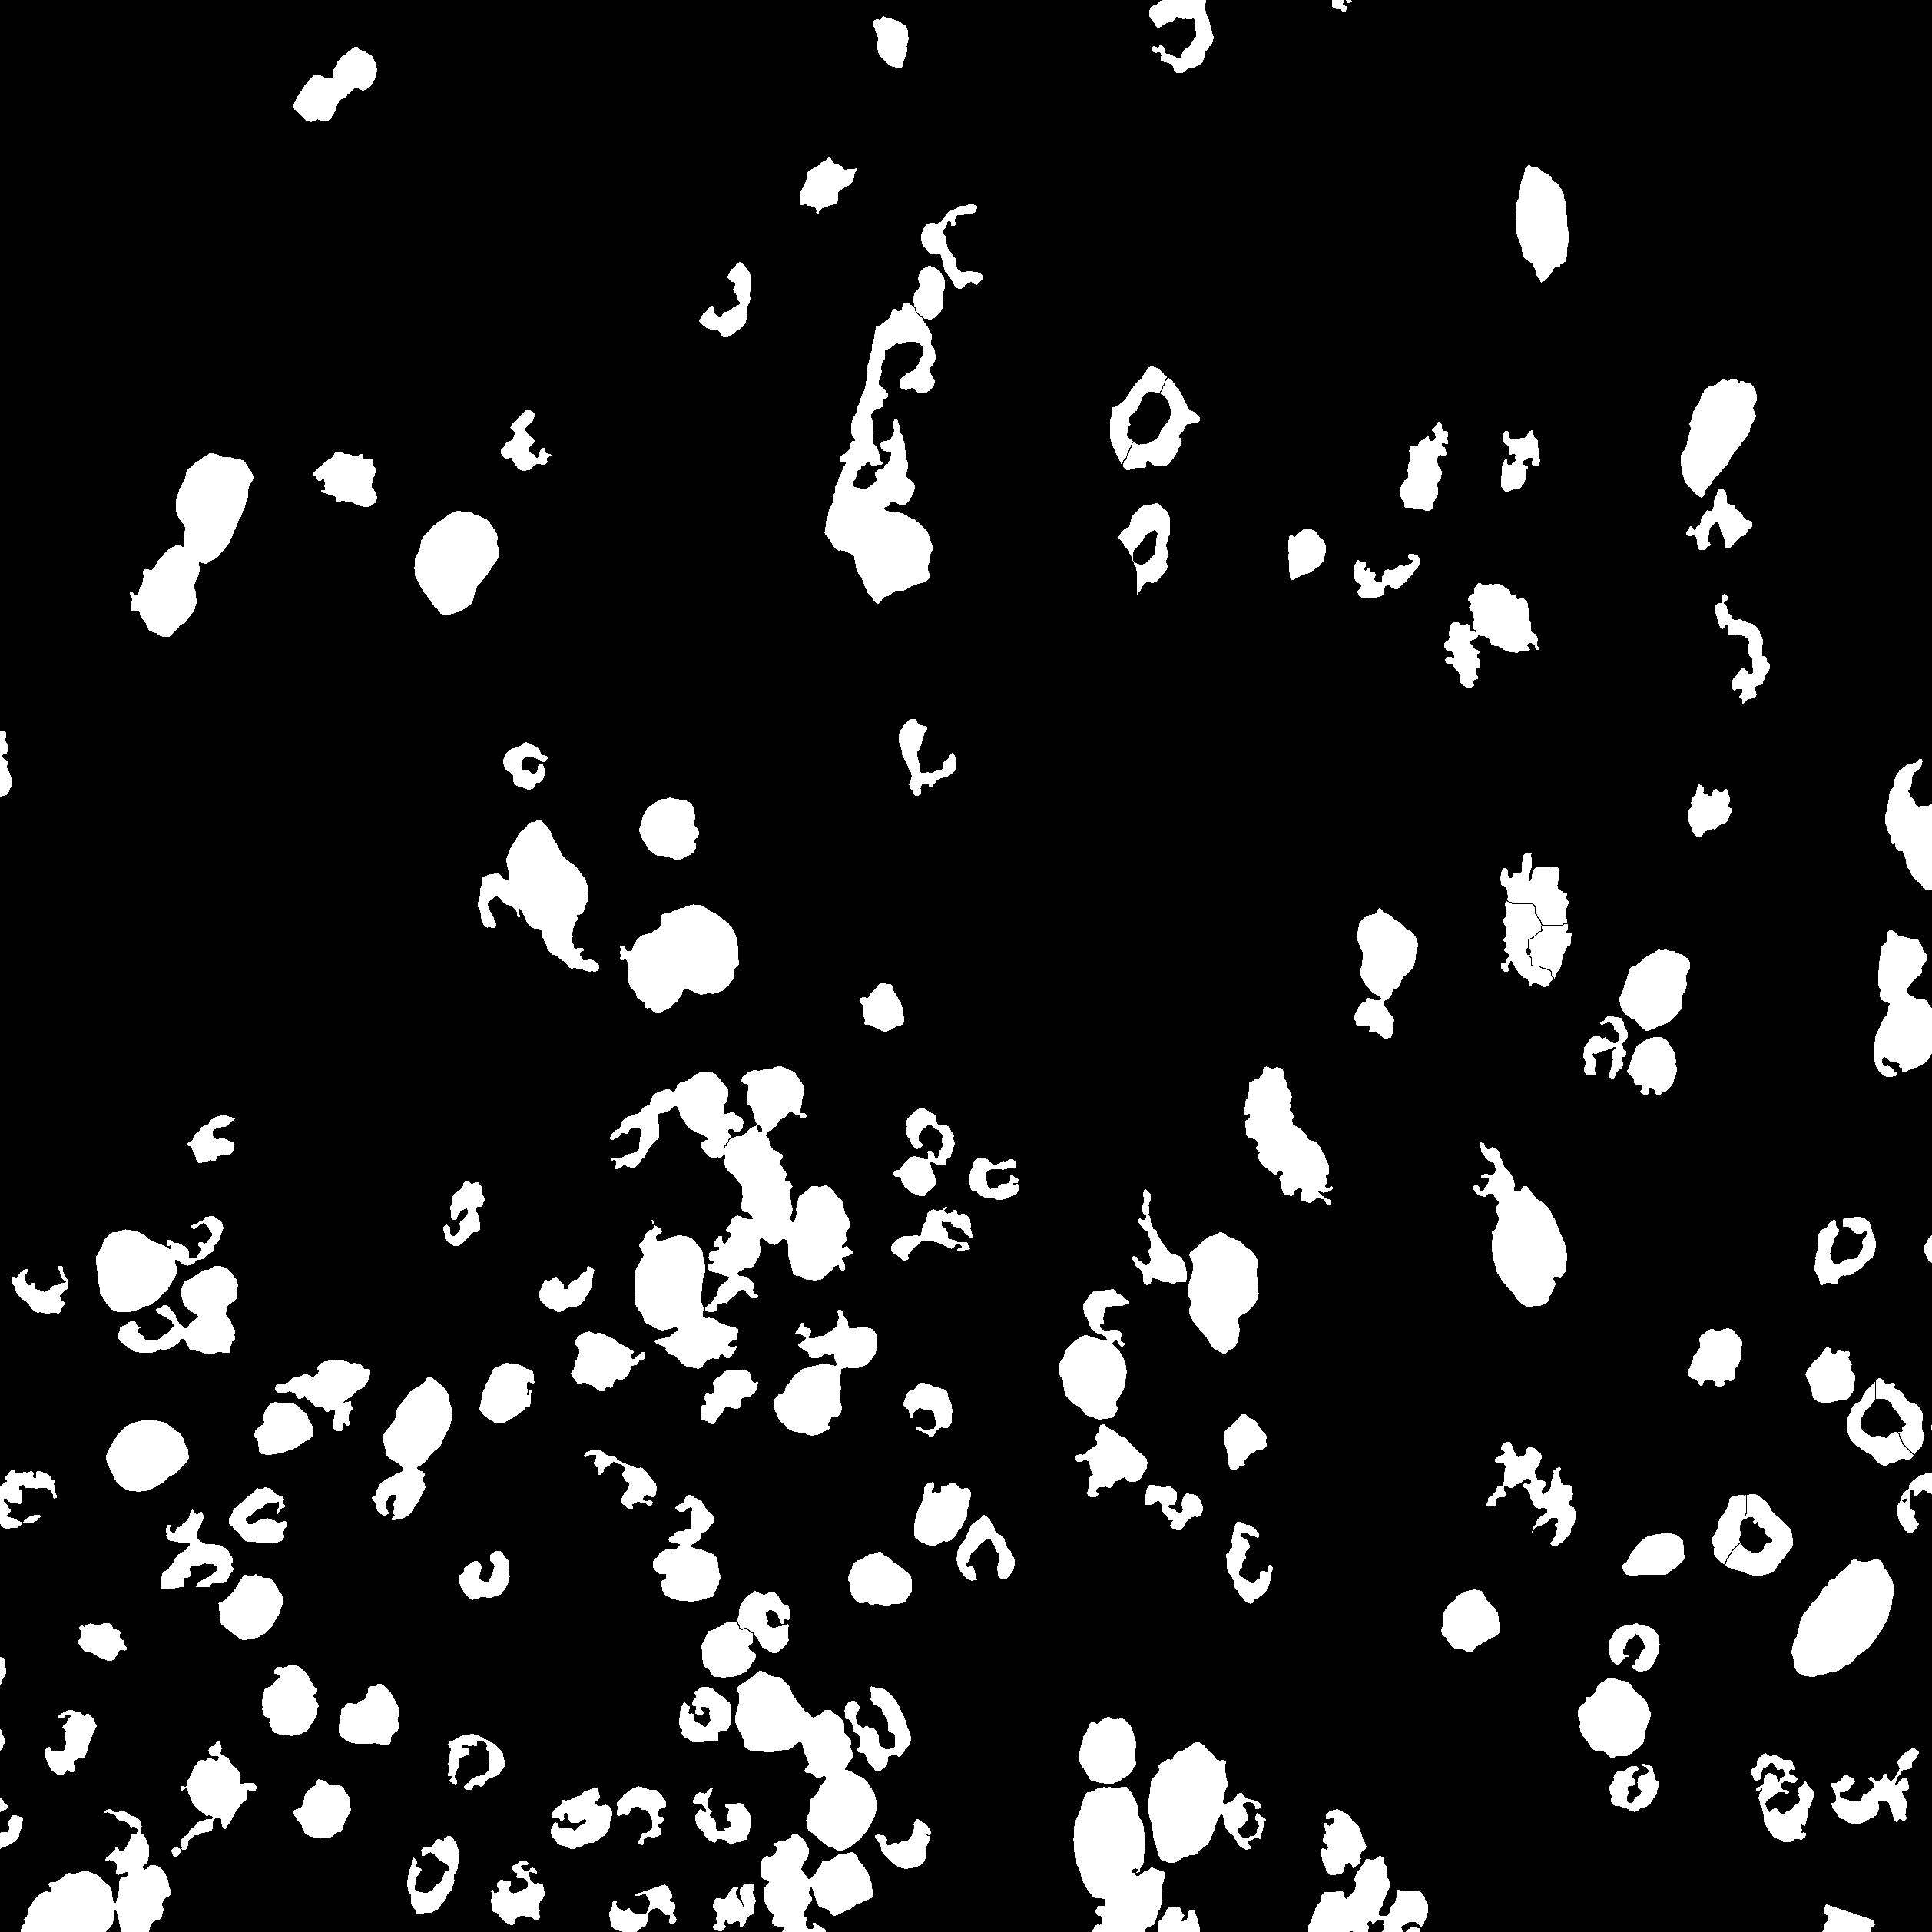
Whole-slide binary mask exports used for fusion with registered IMS and AF data
DBA

Slide 6
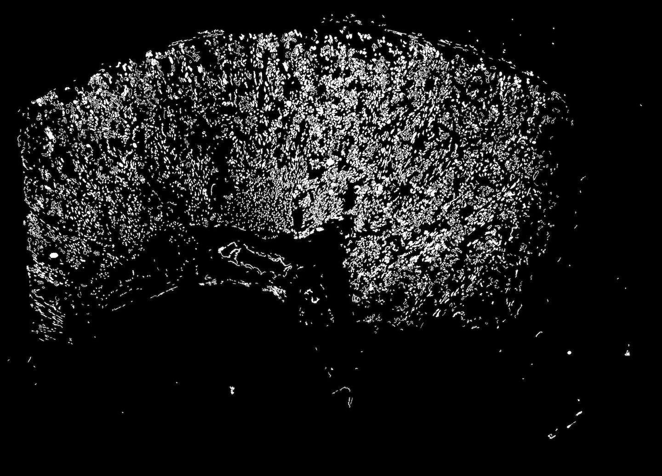
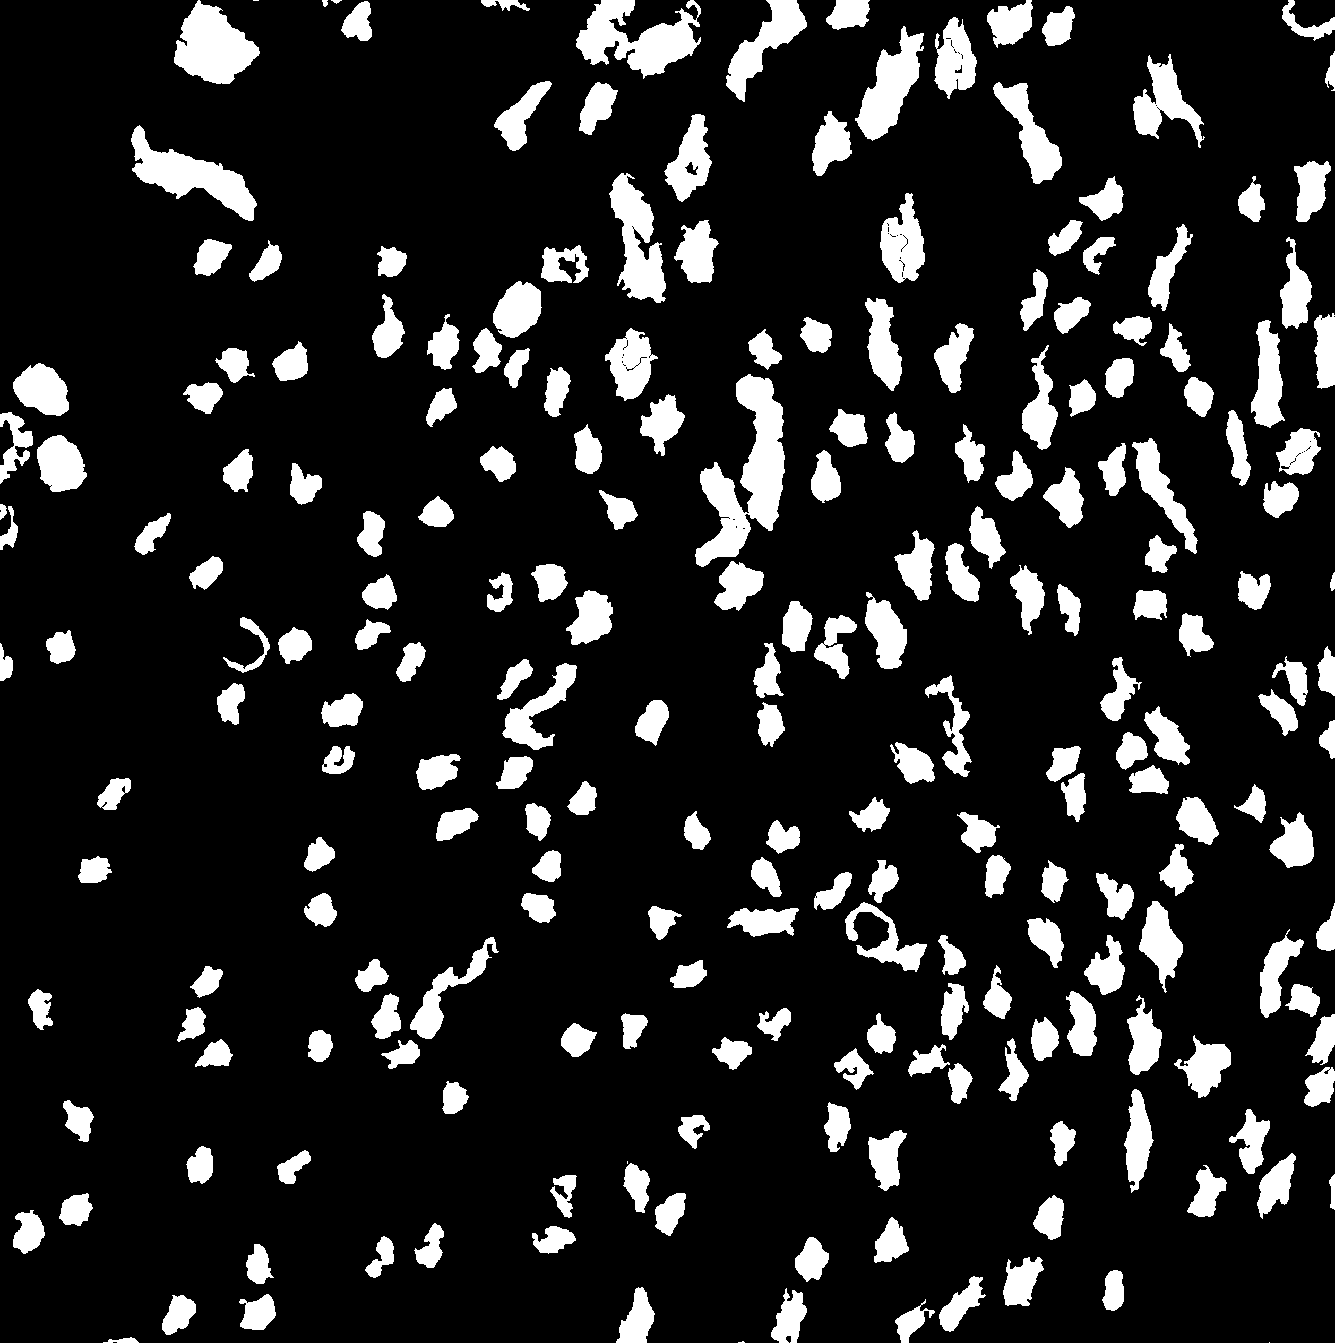
Whole-slide binary mask exports used for fusion with registered IMS and AF data
LTL

Slide 7
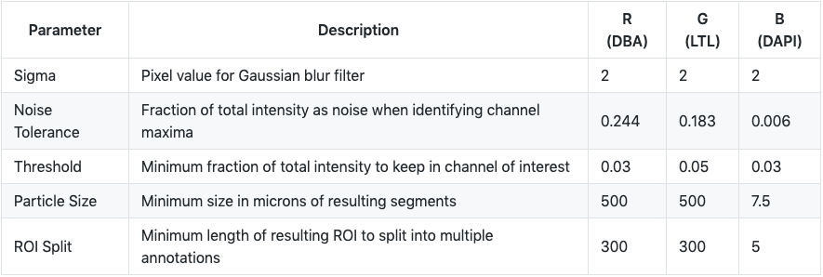
Future work includes hyperparameter optimization and scale-up
Define metric for determining segment quality
Perform guardbanding around hyperparameter values. Initial optimized parameters for MxIF channels from Patient 20 images:
Register individual ROIs and remove redundancies in tile overlap
Scale up QuPath workflow to Python for parallelization and integration in downstream analysis workflows

